Slide 1
Boot camp – part 1
Emanuele Della Valle
Prof. @ Politecnico di Milano
Founder & Partner @ Quantia Consulting
Marco Balduini
Founder & CEO @ Quantia Consulting
Riccardo Tommasini
Prof. @ University of Tartu

Slide 2
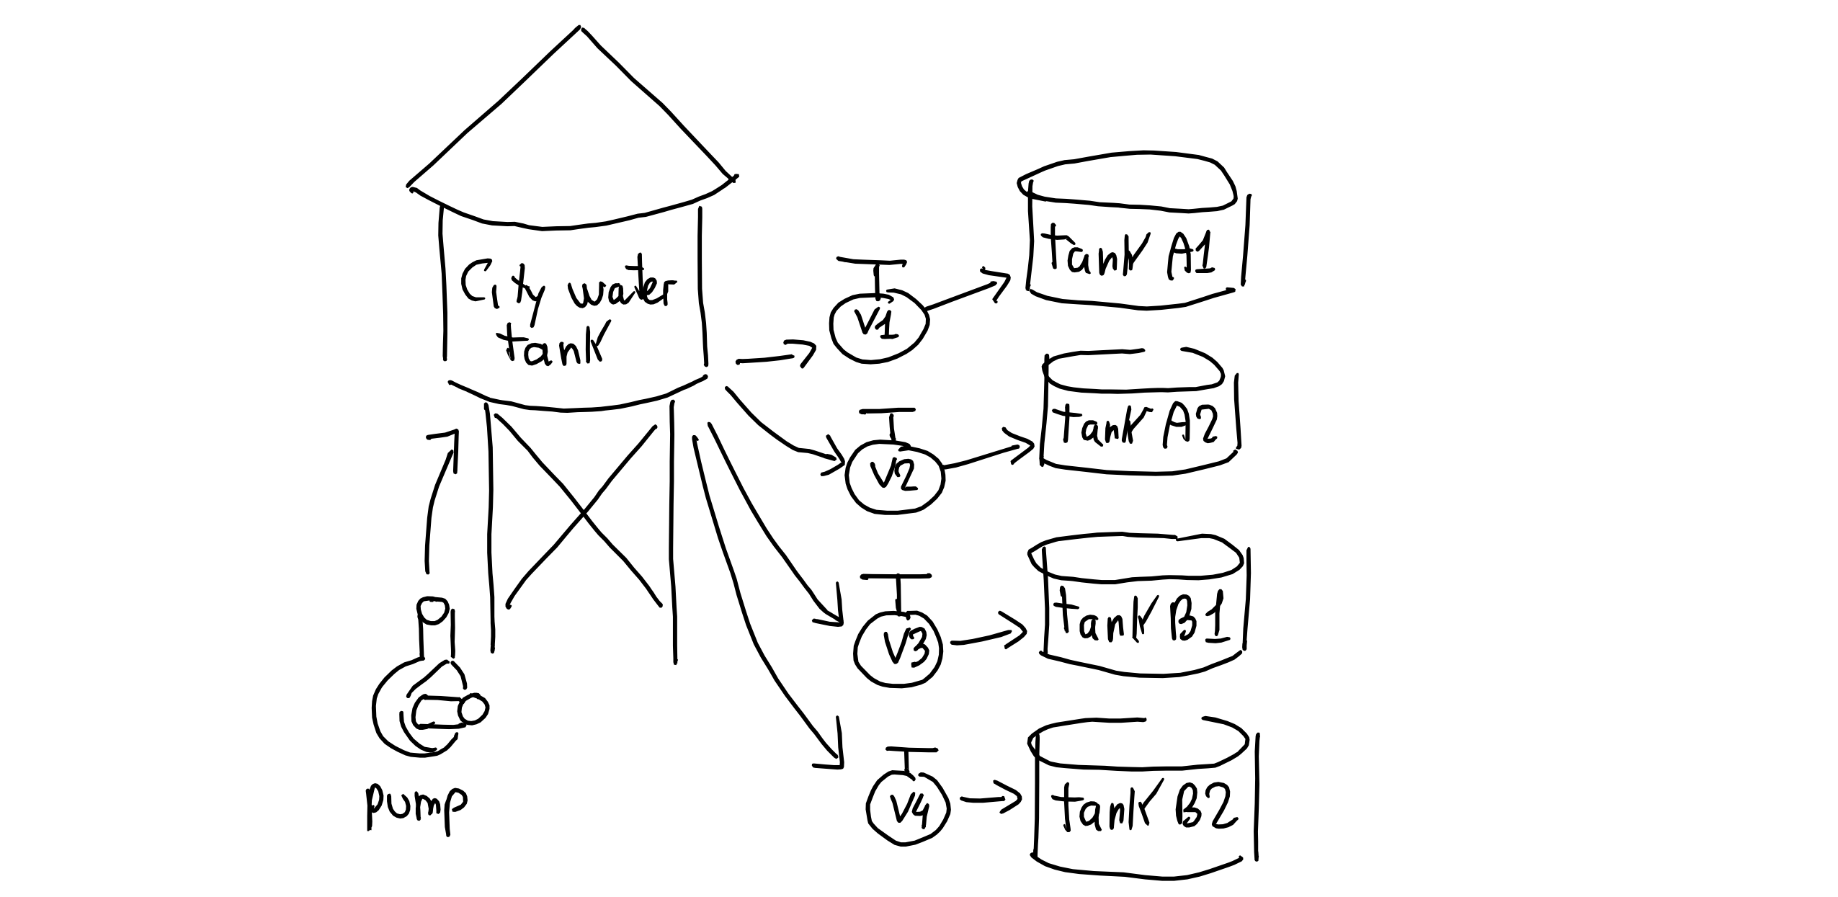
Recall the Demo Scenario

Slide 3
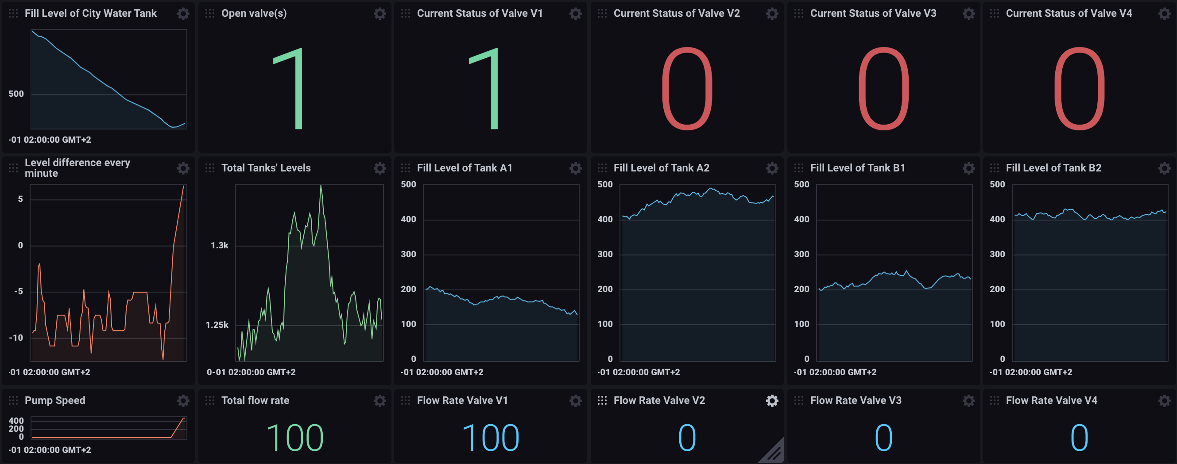
Recall the Dashboard we demoed

Slide 4

Let’s go to the boot camp
BC1

Slide 5
It’s now your turn!

Slide 6
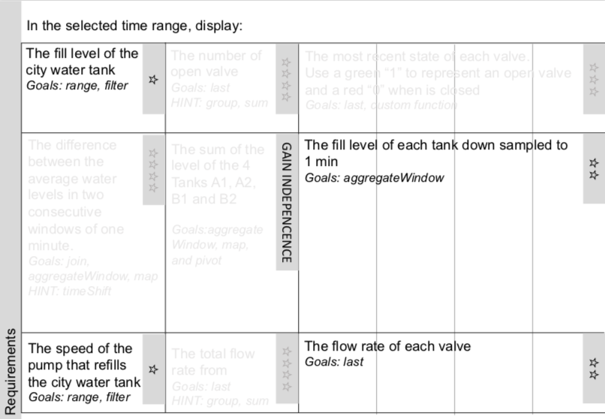
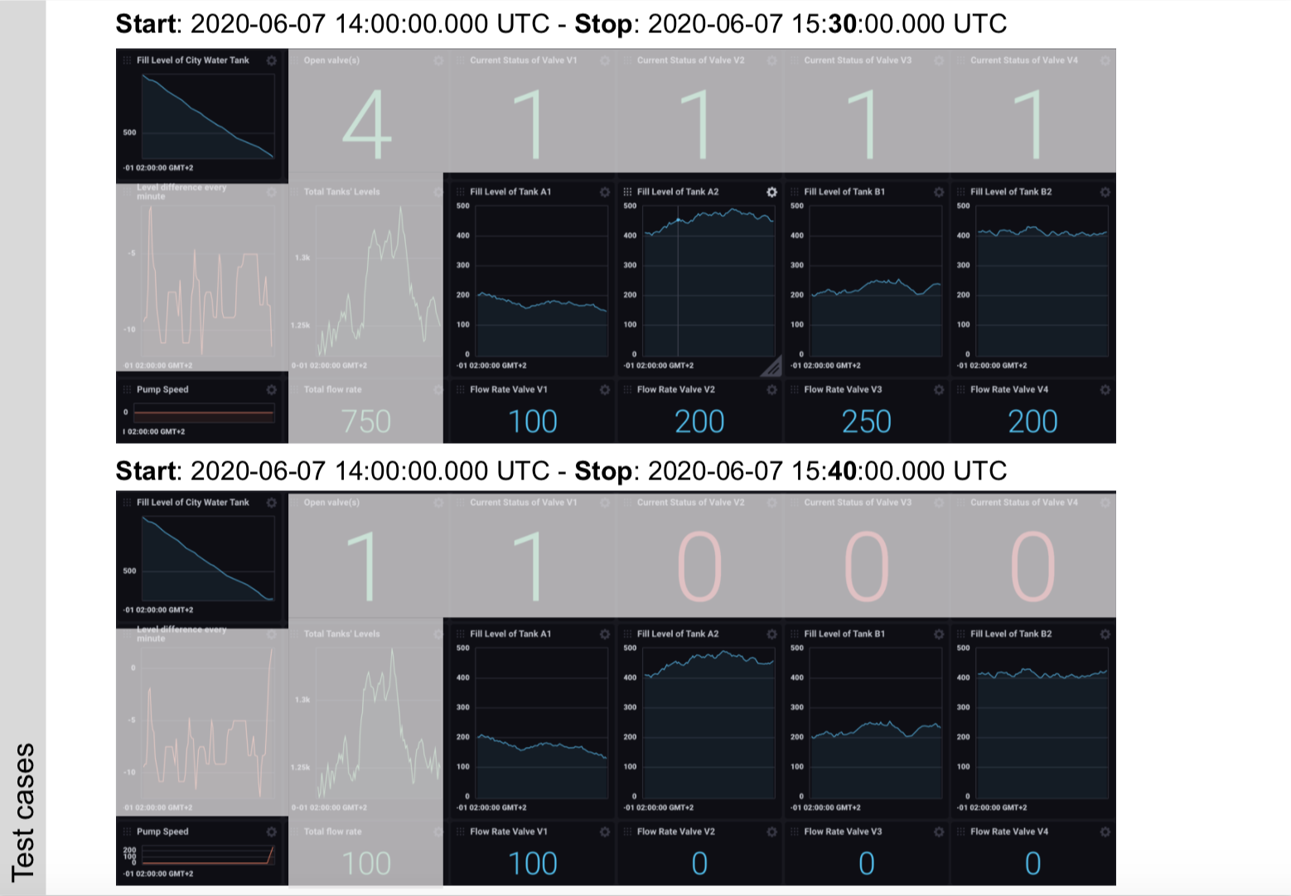
Check out the material we are sharing with you
Requirements
Test cases

Slide 7
Boot camp – part 1
Emanuele Della Valle Prof. @ Politecnico di Milano & Partner @ Quantia Consulting
Marco Balduini Founder & CEO @ Quantia Consulting
Riccardo Tommasini Prof. @ University of Tartu

